Slide 1

FAKEDETECTOR: Effective Fake News Detection with Deep Diffusive Neural Network
IT Department IV YEAR (2017 - 2021)
P. SURYA SARATH 17WJ1A1236
P. SAI VINEET 17WJ1A1238
P. AKHIL 17WJ1A1241
Under the Guidance of
P. NARESH (Assistant Professor)

Slide 2
TABLE OF CONTENT
1. ABSTRACT
2. INTRODUCTION
3. EXISTING SYSTEM
4. DISADVANTAGES OF EXISTING SYSTEM
5. PROPOSED SYSTEM
6. ADVANTAGES OF PROPOSED SYSTEM
7. LITERATURE SURVEY
8. SYSTEM REQUIREMENTS
9. SYSTEM ARCHITECTURE
10. MODULES
11. UML
12. EXCECUTION
13. CONCLUSION

Slide 3
ABSTRACT
In recent years, due to the booming development of online social networks, fake news for various commercial and political purposes has been appearing in large numbers and widespread in the online world.
With deceptive words, online social network users can get infected by these online fake news easily, which has brought about tremendous effects on the offline society already. An important goal in improving the trustworthiness of information in online social networks is to identify the fake news timely.
This paper aims at investigating the principles, methodologies and algorithms for detecting fake news articles, creators and subjects from online social networks and evaluating the corresponding performance.

Slide 4
Based on a set of explicit and latent features extracted from the textual information, FAKEDETECTOR builds a deep diffusive network model to learn the representations of news articles, creators and subjects simultaneously.
Extensive experiments have been done on a real-world fake news dataset to compare FAKEDETECTOR with several state-of-the-art models, and the experimental results are provided in the full-version of this paper.

Slide 5
INTRODUCTION
Fake news denotes a type of yellow press which intentionally presents misinformation or hoaxes spreading through both traditional print news media and recent online social media.
Fake news has been existing for a long time, since the “Great moon hoax” published in 1835 .
In recent years , due to the booming developments of online social networks , fake news for various commercial and political purposes has been appearing in large numbers and widespread in the online world.

Slide 6
During the 2016 US president election, various kinds of fake news about the candidates widely spread in the online social networks, which may have a significant effect on the election results. According to a post-election statistical report online social networks account for more than 41.8% of the fake news data traffic in the election, which is much greater than the data traffic shares of both traditional TV/radio/print medium and online search engines respectively. An important goal in improving the trustworthiness of information in online.
Spams are usually easier to be distinguished; meanwhile, identifying fake news with erroneous information is incredibly challenging, since it requires both tedious evidence-collecting and careful fact checking due to the lack of other comparative news articles available

Slide 7
EXISTING SYSTEM
In December of 2016, a group of volunteers from industry started a contest called the Fake News Challenge.
The goal is to encourage the development of tools that may help human fact checkers identify deliberate misinformation in news stories through the use of machine learning, natural language processing and artificial intelligence.
The organizers decided that the first step is understanding what other news organizations are saying about the topic in question. As such, they decided that stage one of their contest would be a stance detection competition.
The organizers built a dataset of headlines and bodies of text and challenged competitors to build classifiers that could correctly label the stance of a body text and headline, into one of four categories: “agree”, “disagree”, “discusses” or “unrelated.”
The top three teams all reached over 80% accuracy on the test set for this task.

Slide 8
DISADVANTAGES OF EXISTING SYSTEM
Impact on society: Spams are confined to merely local impact on small numbers of audience, while in case of fake news in online social networks can impact tremendously due to massive user number and extensive sharing among user.
Audiences’ initiative: Spams are received in emails passively, users in online social networks receive and share news information actively without conformation.
Identification difficulty: Spams are usually easier to be distinguished, in E-mail by comparison with regular messages. whereas identifying fake news with erroneous information is incredibly challenging.
Since it requires both tedious evidence-collecting and careful fact-checking due to the lack of other comparative news articles available.

Slide 9
PROPOSED SYSTEM
In this paper, we will study the fake news detection problem in online social networks.
Based on various types of heterogeneous information sources, including textual contents/ profile/descriptions and the authorship and article-subject relationships among them, we aim at identifying fake news from the online social networks simultaneously.
We formulate the fake news detection problem as a credibility inference problem, where the real ones will have a higher credibility while unauthentic ones will have a lower one instead.
FAKEDETECTOR aims at learning a prediction model to infer the credibility labels of news articles, creators and subjects simultaneously.

Slide 10
ADVANTAGES OF PROPOSED SYSTEM
Designed an efficient deep neutral network combining the content level features of news articles with user’s social engagement to achieve significant results.
Gives more Accuracy than the previous model
Implemented a tensor factorization based approach with content as well as context based information
Performed extensive feature set based studies for the classification of fake news

Slide 11
LITERATURE SURVEY
Title: Opinion fraud detection in online reviews by network effects
Author: L. Akoglu, R. Chandy, and C. Faloutsos
Year: 2013
Description:
User-generated online reviews can play a significant role in the success of retail products, hotels, restaurants, etc. However, review systems are often targeted by opinion spammers who seek to distort the perceived quality of a product by creating fraudulent reviews. We propose a fast and effective framework, FRAUDEAGLE, for spotting fraudsters and fake reviews in online review datasets.

Slide 12
Title: Social media and fake news in the 2016 election.
Author: H. Allcott and M. Gentzkow
Year: 2017
Description:
Following the 2016 U.S. presidential election, many have expressed concern about the effects of false stories (“fake news”), circulated largely through social media. We discuss the economics of fake news and present new data on its consumption prior to the election. Drawing on web browsing data, archives of fact-checking websites, and results from a new online survey, we find:

Slide 13
Title: Detecting and characterizing social spam campaigns
Author: H. Gao, J. Hu, C. Wilson, Z. Li, Y. Chen, and B. Zhao
Year: 2010
Description:
Online social networks (OSNs) are popular collaboration and communication tools for millions of users and their friends. Unfortunately, in the wrong hands, they are also effective tools for executing spam campaigns and spreading malware. Intuitively, a user is more likely to respond to a message from a Facebook friend than from a stranger, thus making social spam a more effective distribution mechanism than traditional email. In fact, existing evidence shows malicious entities are already attempting to compromise OSN account credentials to support these “high-return” spam campaigns.

Slide 14
SYSTEM REQUIREMENTS
HARDWARE REQUIRMENTS:
PROCESSOR : DUAL CORE 2 DUOS.
RAM : 4GB DD RAM
HARD DISK : 250 GB
Monitor : 15’’ LED
Input Devices : Keyboard, Mouse

Slide 15
SYSTEM REQUIREMENTS
SOFTWARE REQUIRMENTS:
OPERATING SYSTEM : WINDOWS 7/8/10
PROGRAMMING LANGUAGE : PYTHON

Slide 16
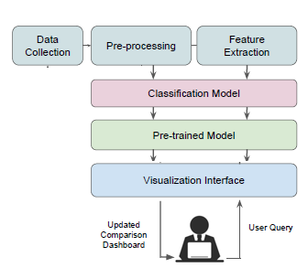
SYSTEM ARCHITECTURE

Slide 17
Data Collection :
Collection of data from various websites
Preprocessing:
In this processing, we created a data set table utilizing the data collected from various sources. Arrange it in the format of ID ( Unique entification Number ) title, Author, Text and, Label ( Which might be reliable or not reliable )
Feature Extraction:
In this, we remove noisy data from the dataset and unnecessary symbols. Then we collect key attributes unique to its dataset and this attribute is used in the further processing.

Slide 18
Classification Model:
After completion of feature extraction and preprocessing, then the data is categorized into groups based on the theme of the data.
Pre-trained Model :
After the completion of classifying the dataset, in this process, we will be training the dataset using a fake detector algorithm with a deep diffusive neural network and save the trained data in the system.
Visualization Interface:
It is a graphical user interface where the system takes the user's query and gives the results.

Slide 19
MODULES
Data Collection :
This is the first real move towards the real growth of a machine learning model, gathering data. This is a crucial step that will cascade in how great the model will be, the more and more reliable data that we get, the greater our model will perform. There are various techniques to get the data, like network scraping, manual invasions, etc. The dataset used in this Fake news Detection taken from Kaggle.
Dataset :
The dataset is appraised of 20800 individual data. It consists of 5 columns in the dataset, which are
1) Id: Unique identification number for a news article.
2)Title: The title of the news article.
3)Author: The author of the news article.
4)Text: The text of the article; could be incomplete.
5)Label: A label that marks the article as potentially unreliable or reliable by using either ‘ 1’ or ‘0’.
1: unreliable 0: reliable

Slide 20
Data Preparation :
The data transformation can be completed by getting rid of missing data and removing columns. First, the transformation process creates a list of column names that will be kept or retained. Next, it drops or removes all columns except for the columns that willingly retain. Finally, it drops or removes the rows that have missing values from the data set.
Model Selection:
Passive-Aggressive algorithm is also used but in base paper a neural network algorithm is given. The Passive-Aggressive algorithm is a subclass of Machine learning algorithms that is not very well versed by beginners and intermediate Machine Learning enthusiasts. The algorithm is used as it is efficient for particularly specific applications .

Slide 21
Analyse and Prediction:
In the actual dataset, we chose only 2 features:
1. Text: the text of the article; could be incomplete
2. Label: a label that marks the article as potentially unreliable
1: FAKE
0: REAL
Saving the Trained Model :
When the tested and trained model is sent into the production-ready environment, the first step is to save it into a.h5 or. pkl file using a library I like pickle. Make sure that the pickles are installed in your environment. Now, import the module and dump the model into pkl.file

Slide 22
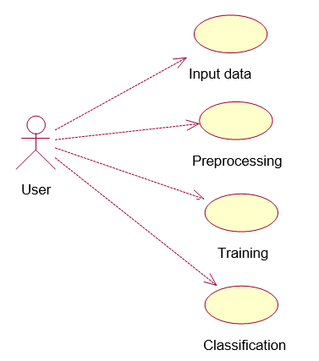
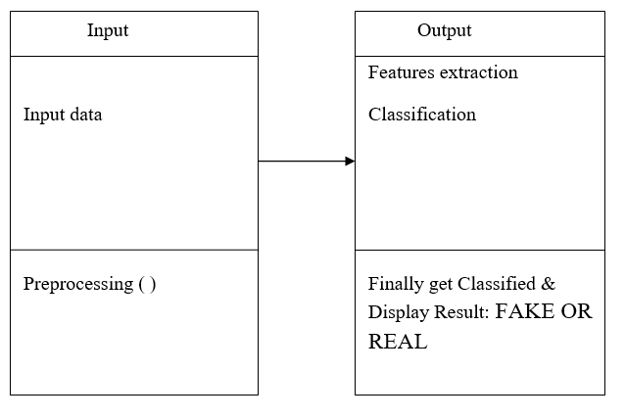
UML

Slide 23
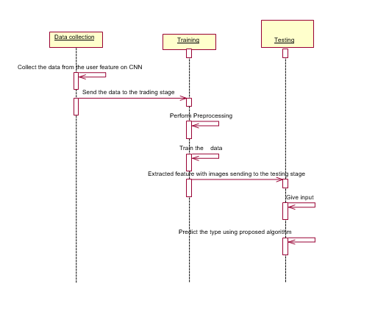
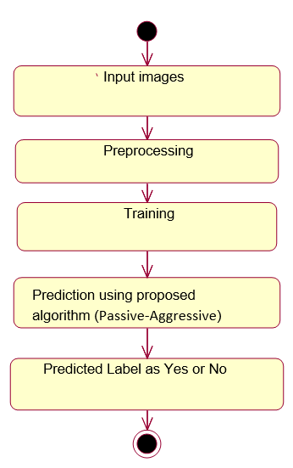

Slide 24
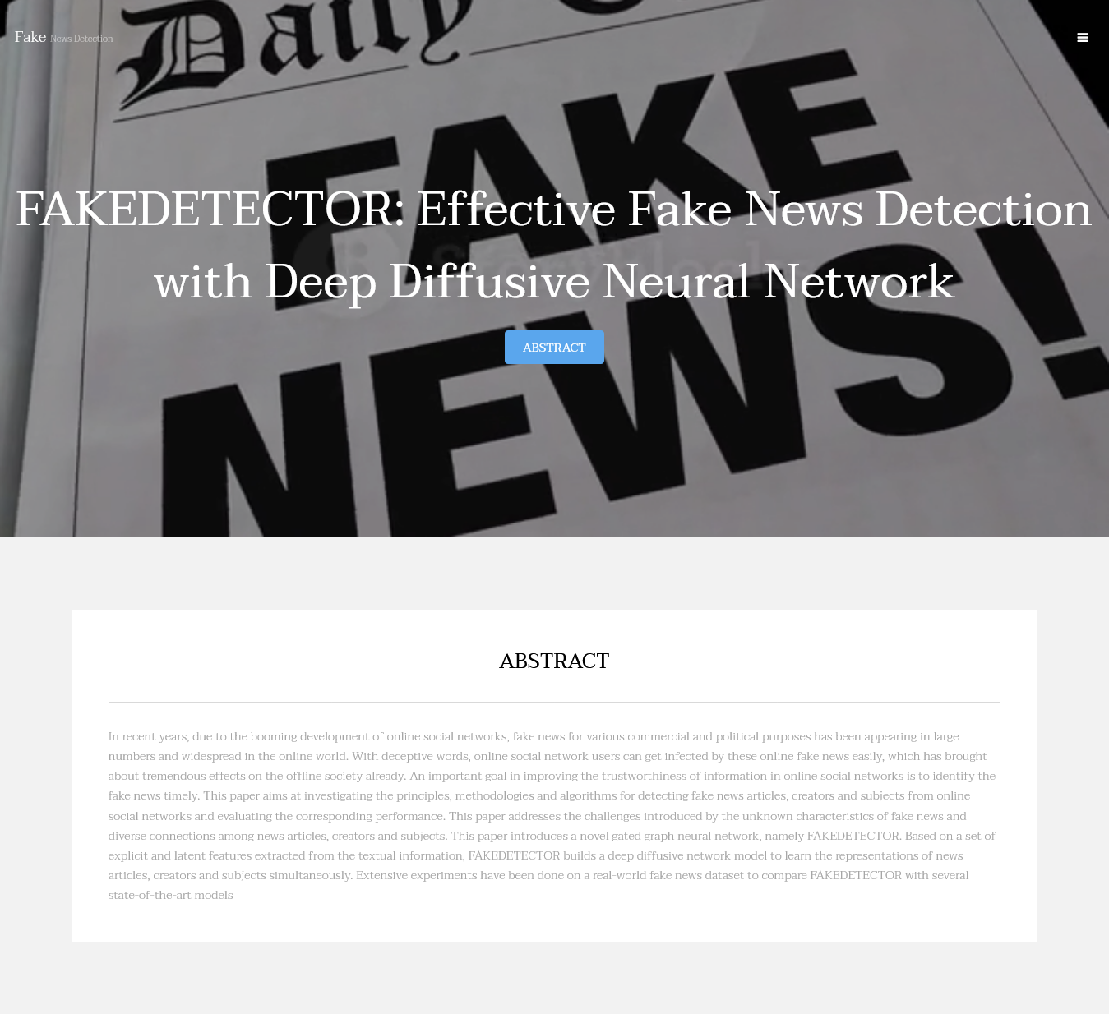

EXCECUTION

Slide 25

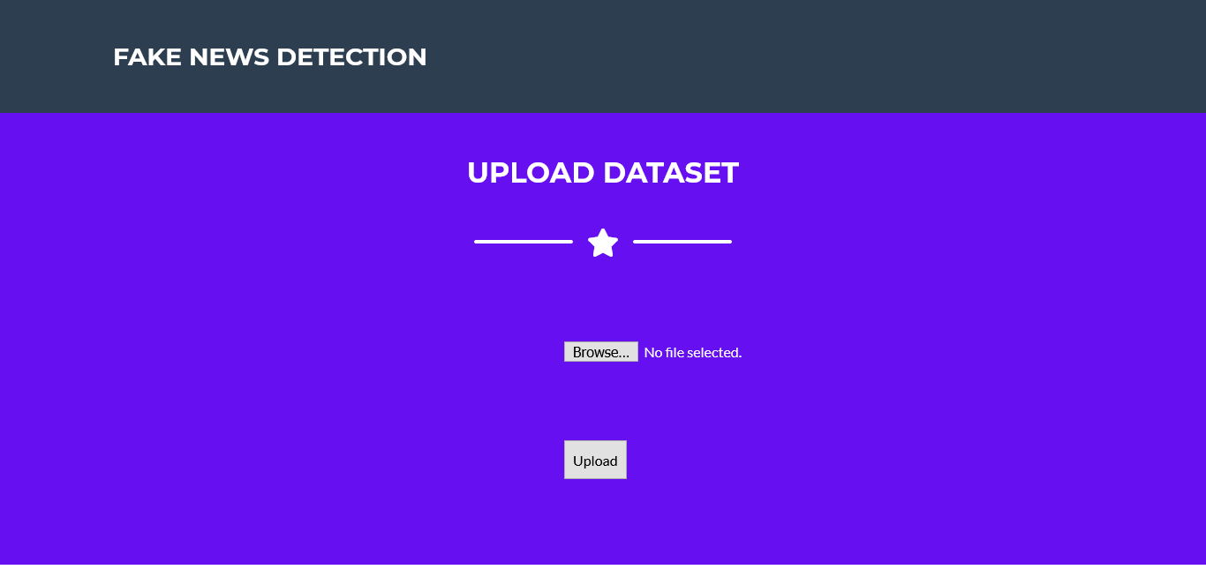
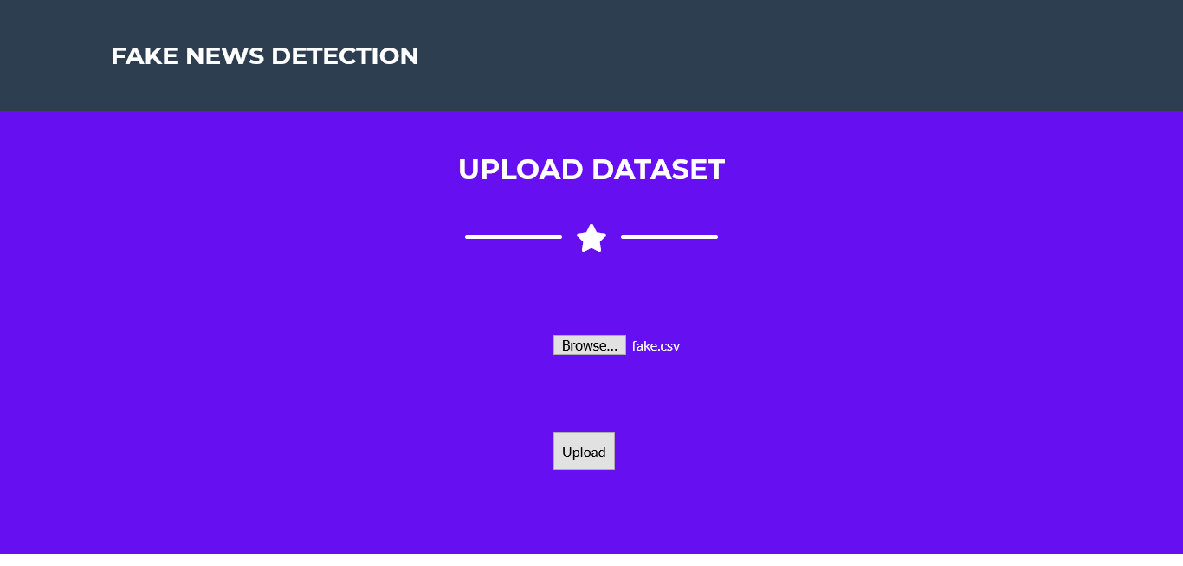
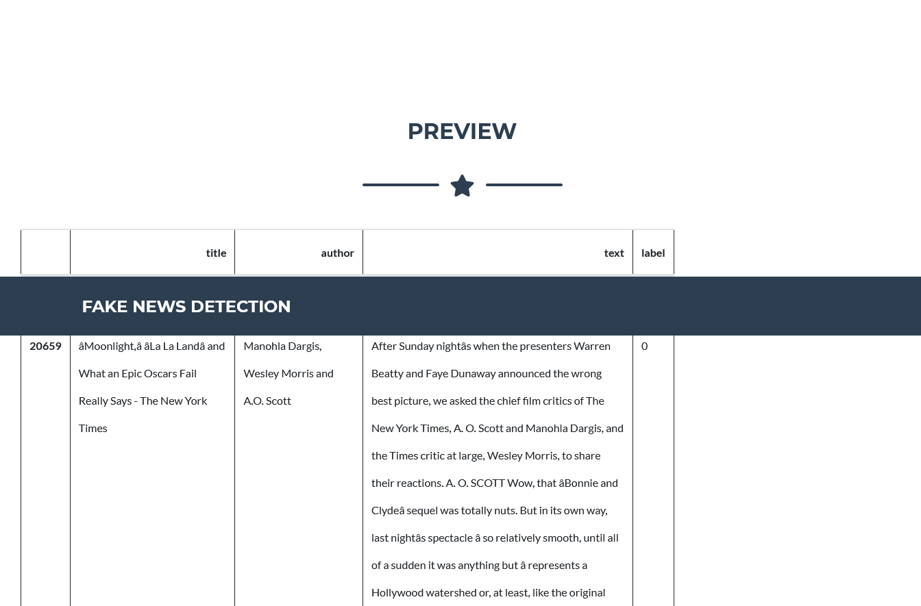

Slide 26
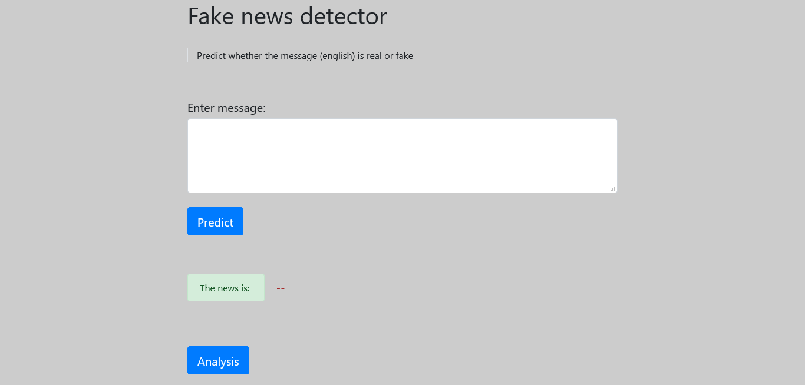
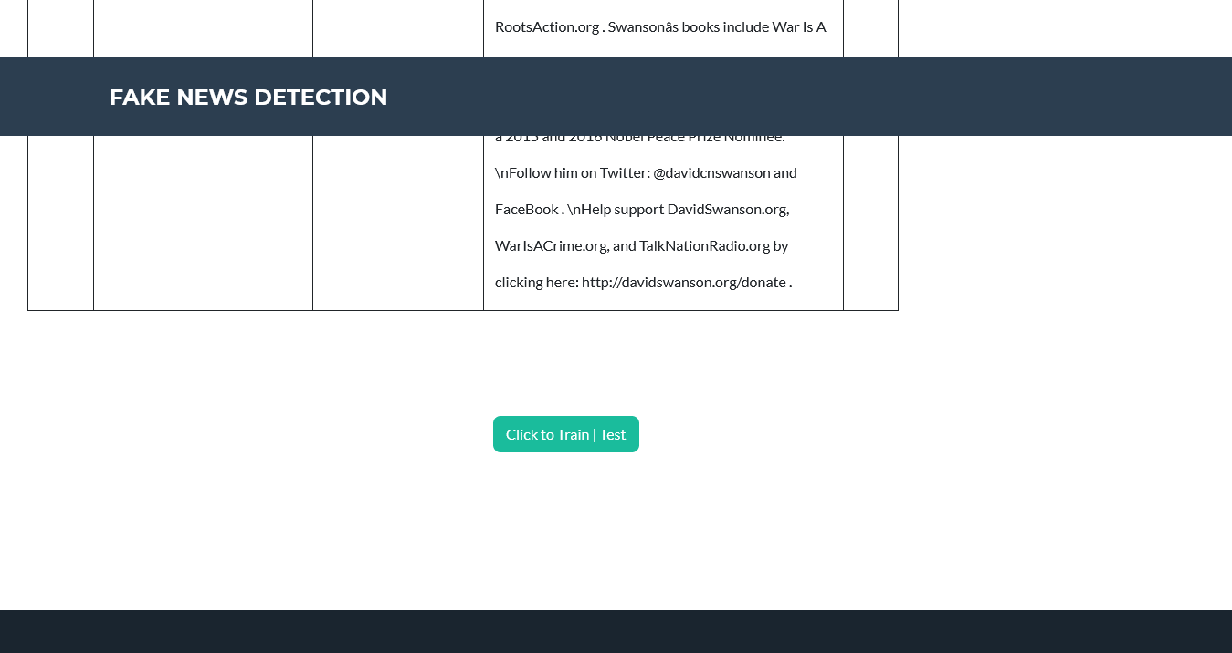
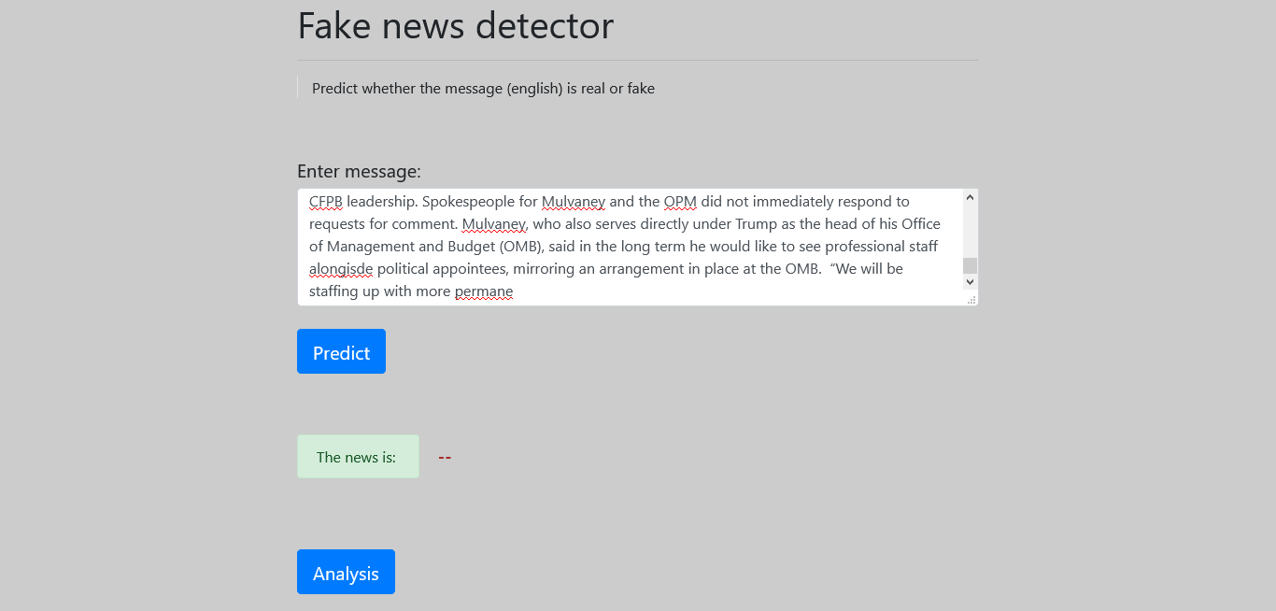


Slide 27
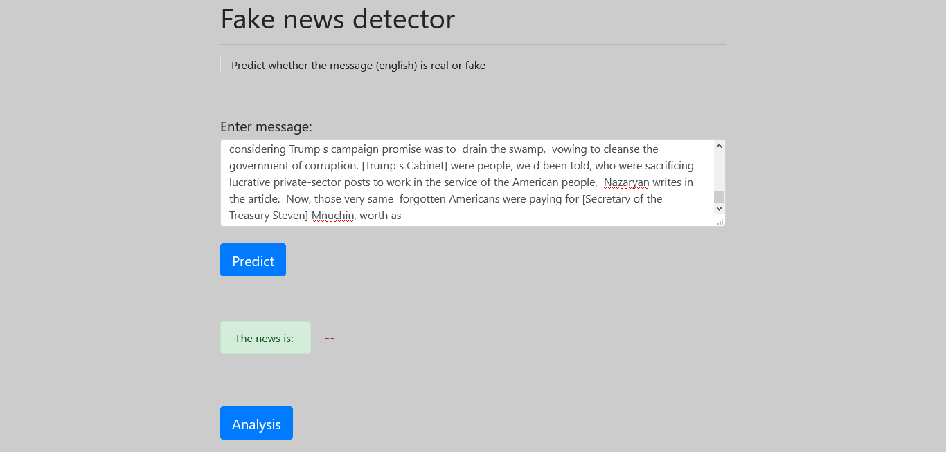

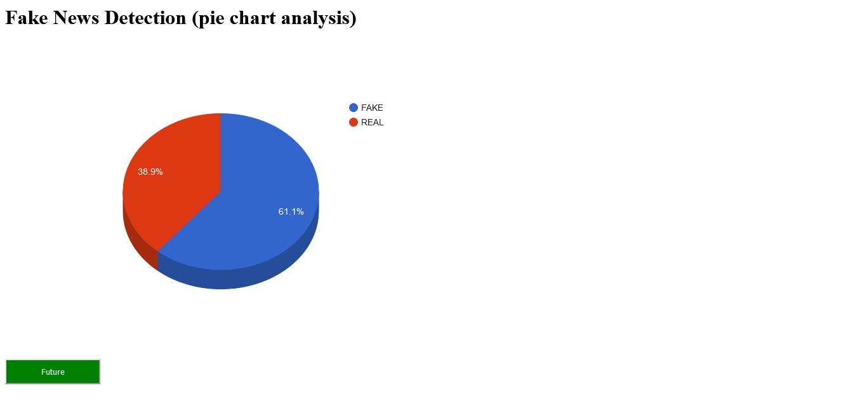

Slide 28
CONCLUSION
The main contribution of this project is support for the idea that machine learning could be useful in a novel way for the task of classifying fake news. Our findings show that after much pre-processing of relatively small dataset, a simple CNN is able to pick up on a diverse set of potentially subtle language patterns that a human may (or may not) be able to detect. Some such intuitive patterns that our model has found to indicate fake news include generalizations, colloquialisms and exaggerations.
Likewise, our model looks for indefinite or inconclusive words, referential words, and evidence words as patterns that characterize real news. Even if a human could detect these patterns, they are not able to store as much information as a CNN model and may not understand the complex relationships between the detection of these patterns and the decision for classification.

Slide 29
REFERENCES
L. Akoglu, R. Chandy, and C. Faloutsos. Opinion fraud detection in online reviews by network effects. In ICWSM, 2013.
H. Allcott and M. Gentzkow. Social media and fake news in the 2016 election. Journal of Economic Perspectives, 2017.
J. Chung, K. Cho, and Y. Bengio. Empirical evaluation of gated recurrent neural networks on sequence modelling. CoRR, abs/1412.3555, 2014.
H. Gao, J. Hu, C. Wilson, Z. Li, Y. Chen, and B. Zhao. Detecting and characterizing social spam campaigns. In IMC, 2010.

Slide 30
THANK YOU

